Slide 1
Elastic Network Slicing and Admission Control
Divya K

Slide 2
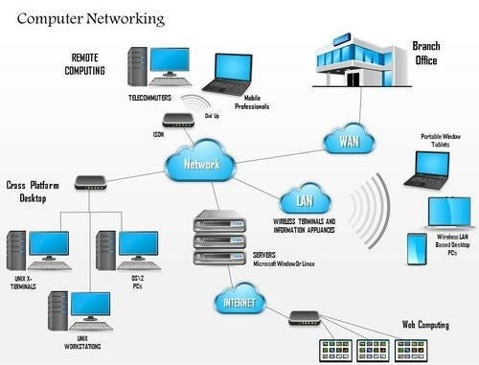
What is a Computer Network?
Visual: Cities connected by roads = devices connected by cables
Nodes = computers/servers
Links = data roads
We send requests from one node to another.

Slide 3
What Happens When You Use the Internet?
A request is made (e.g., watch a video)
It goes from Source to Destination
Needs speed (bandwidth), path (routing), and service (compute node)
Notes:
Services such as Firewall, Compressor

Slide 4
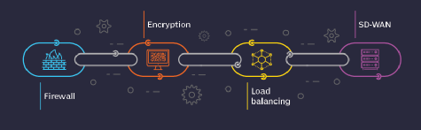
What is a Service Function Chain (SFC)?
Think of it as a checklist: a message must pass through several checkpoints
Example: Spam check → virus check → compress → deliver
These checkpoints are called VNFs (Virtual Network Functions)

Slide 5
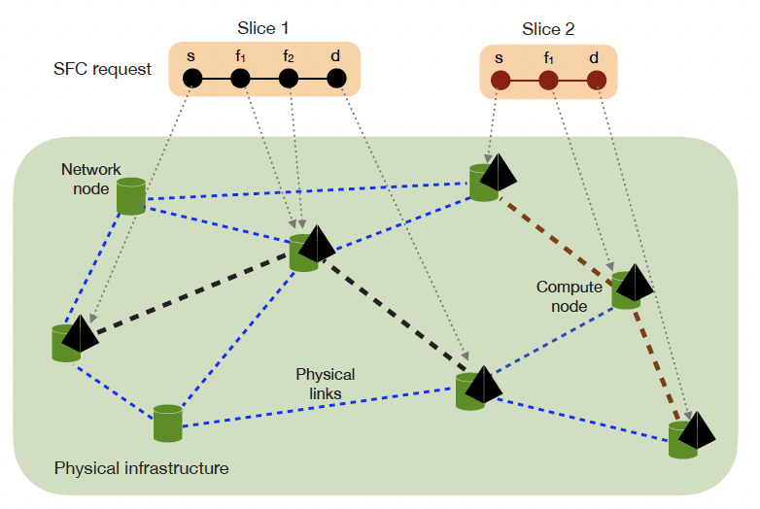
What is Network Slicing?
Just like slicing a pizza for different toppings: one network, many “custom” mini-networks
Each slice gets only what it needs: bandwidth, compute power, and reliability
Slices can grow/shrink: these are elastic slices

Slide 6
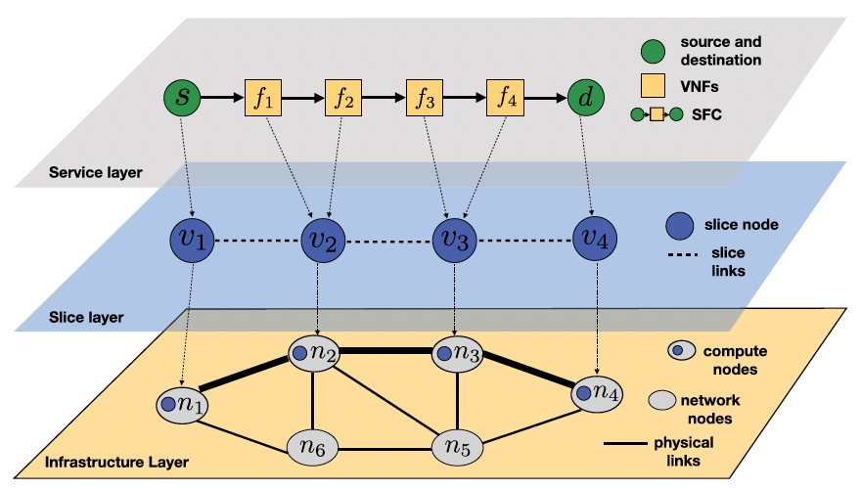
SFC Mapping and the Challenge
Mapping means deciding where the VNFs will live
Need to match the service with physical resources in the network
Goal: minimum cost, maximum efficiency

Slide 7
What is Bandwidth?
Analogy: Road width or number of lanes
Bigger requests need more lanes
Base rate (like a bike) vs. Peak rate (like a truck)
Dynamic Requests
Some requests grow in demand — like needing a 2-lane road for rush hour
Network must be ready to handle base and peak levels

Slide 8
What is Availability? Why is it Important?
Availability = “How often is this path/service working?”
If it's 99.9% available, it fails only 1 out of 1000 times
In critical services like health or finance, even 0.1% matters

Slide 9
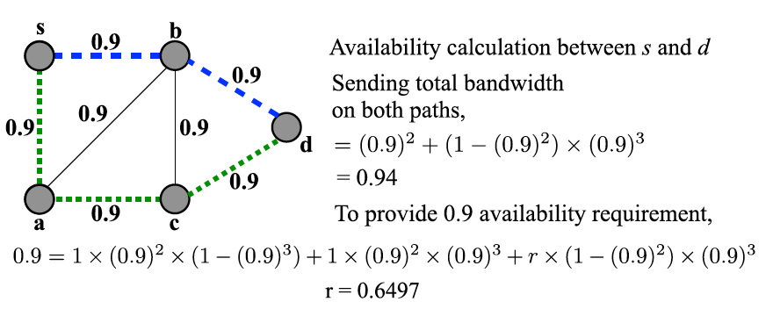
What is Traffic-Weighted Availability?
Normal availability = % time available
Traffic-weighted = “How much of my actual need is being met?”
Example: If I need 100 units only half the time, do I get them when I need?

Slide 10
Admission Control: Who Gets In?
Too many requests = traffic jam
Too few requests = resource wastage
Admission control = security at the gate: "Do we have space and service for you?"
A request can be accepted or rejected based on availability + bandwidth

Slide 11
Task — Single Link with Admission Control
One road (link) connects two cities (nodes)
Requests come in with two different bandwidth requests (base and then may or may not go to peak) and dynamic timing
Students will design logic (greedy first, then RL) to admit or block requests
11

Slide 12
resources
https://www.youtube.com/watch?v=SEL-9-P9J8A&ab_channel=Mpirical
https://www.youtube.com/watch?v=CPBMBLeeD6g&ab_channel=WinInk
https://www.youtube.com/watch?v=wSlvo1WqaV8&ab_channel=CodiLime
https://www.youtube.com/watch?v=lSI3F7T-3AM&ab_channel=AnkitVerma

